Slide 1
Mouse Controls 1 – Mouse Buttons

Slide 2
What are events?
Event programming is a very useful (and not at all obvious!) way to write complicated programs without being overwhelmed by its complexity
The idea is that any significant interaction the user makes with the program generates an event. Some of these events are handled by the program and different events are handled differently.

Slide 3
Pygame Events
Throughout the running of a pygame program, events are constantly being created. Some examples:
  QUIT – the event to trigger the user wants to quit pygame
  MOUSEMOTION – If the mouse moved
  MOUSEBUTTONDOWN/MOUSEBUTTONUP – If a mouse button was pressed or released
  KEYDOWN/KEYUP – if a key on the keyboard was pressed and/or released

Slide 4
Using Mouse Buttons in Pygame
Pygame registers two different events for mouse buttons
  A MOUSEBUTTONDOWN event is created when a mouse button is pressed down
  A MOUSEBUTTONUP event is created when a mouse button is released
Pygame adds information about the event such as:
  Which button is pressed (as an integer)
    1 = left button, 2 = middle button, 3 = right button, 4 = wheel up, 5 = wheel down
  The (x,y) location on the screen the mouse was pointing to when the event occurred

Slide 5
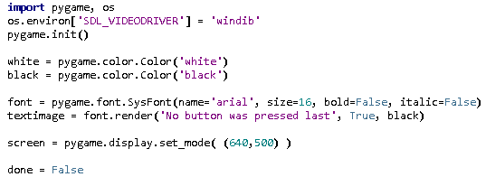
Example 1 – Displaying Event Information

Slide 6
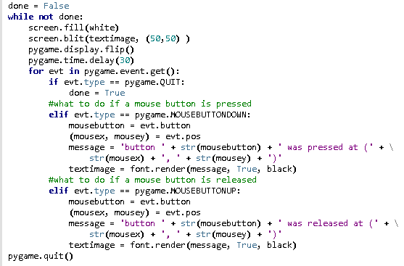
Example 1

Slide 7
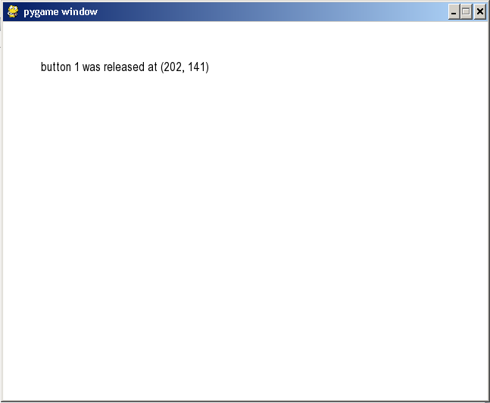

Slide 8
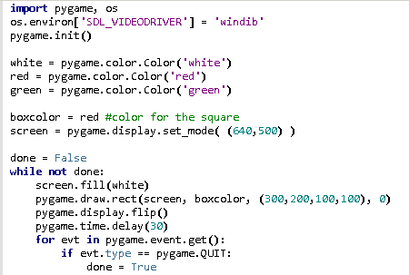
Example 2 – Simulating Buttons

Slide 9
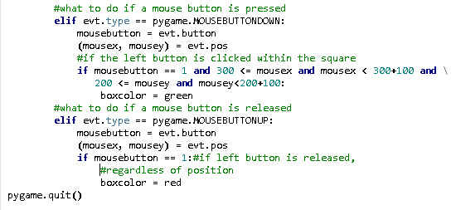

Slide 10
